Slide 1
Automation Testing Goal Update

Slide 2
Introduction to Test Automation
In manual testing, testing of a Mobile/Web application is done manually, by human action, Someone actually goes on a device to evaluate numerous components including design, functionality, and performance. But, manual testing can be mundane, error-prone, time-consuming, often repetitive and even boring. Whereas automation testing uses the assistance of tools, scripts, and software to perform test cases on various levels of the software.
Some of the advantages of test automation over manual testing are as follows:
Improves test accuracy
Saves time and effort
It offers test coverage
Increases test case efficiency
Reduces maintenance costs
Increases the speed of the execution
Reduces manual intervention

Slide 3
One of the most common mistakes with test automation is going for the immediate benefits and forgetting about the bigger picture. Many teams abandon their automation efforts after a sprint or two and go back to manual testing. Now, why do you think that happens?
Most of the time, most of these companies use automation just because others are using it. Here are some of the problems:
Companies are not sure of the right way to implement test automation
They do not have the right automated testing methods in place
Companies may not know when to implement test automation and when not to
They are not aware of the right set of tools that meet their requirements
So, what they need here to succeed in test automation is careful planning and strategy: Test Automation Strategy.

Slide 4
What should automation accomplish ?
The most basic goals of automation are universal
Reduce Time
Improve Coverage
Improve Test
Quality
Save Money
Eliminate human error.
Execute tests in a consistent manner
Cost of incremental test execution is reduced.
Frees up headcount to focus on other tasks.
Complete test execution faster than a person can.
Execute multiple tests in parallel.
Shorten time frame required to complete testing.
Decrease time to market.
Data driven automation allows for more testing variation than what would be humanity possible.
Avoids reducing test coverage due to time constraints.

Slide 5
Not So fast …
Automation ROI can be quickly drained by
Focusing only on UI-based test automation or using the wrong approach or tool for an automation need.
“Automate everything” mindset.
Poorly designed test scripts break down when attempting to scale.
Automation Approach
Lack of structured metrics, KPI’s and difficulty communicating ROI.
Test automation treated as a independent, siloed capability.
Resources with automation strategy skills.
Operations & Overhead
Automation
Benefit
Limiting automation to only testing.
Using old tools for new problems.
Spending time reinventing the wheel instead of leveraging the testing community and resources.
Testing teams unable to work with automation to solve their biggest problems.
Innovation
Maintenance
Maintenance efforts to become unmanageable when the right solution isn’t used.
Frequent application changes break scripts.
Time

Slide 6
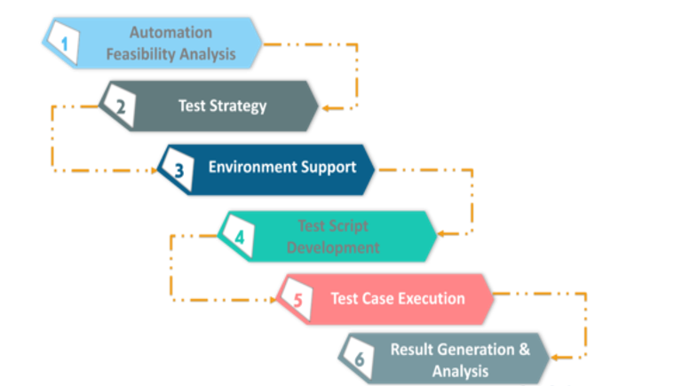
Test Automation Life Cycle
Automation test life cycle has the following phases

Slide 7
Current framework can be improved with below key features :
1. Adopting to latest designs BDD , TestNG.
2. No Design patterns followed(Driver creations single ton , data manage by factory pattern)
3. Webservices automation with BDD(Currently in SOAPUI all cases are executed with help of herms and groovy - Manual Testing extension).
4. Generic selenium helpers
5. Generic Java helpers
6. Synchronization (waits before or after performing actions)
7. Customised Reporting .
8. Context features (Adding and retrieving data dynamically)
9. Cloud executions (Kubernetes cluster or AWS)
10. Parallel executions , Cross browser validations , Visual validations not implemented.

